Slide 1
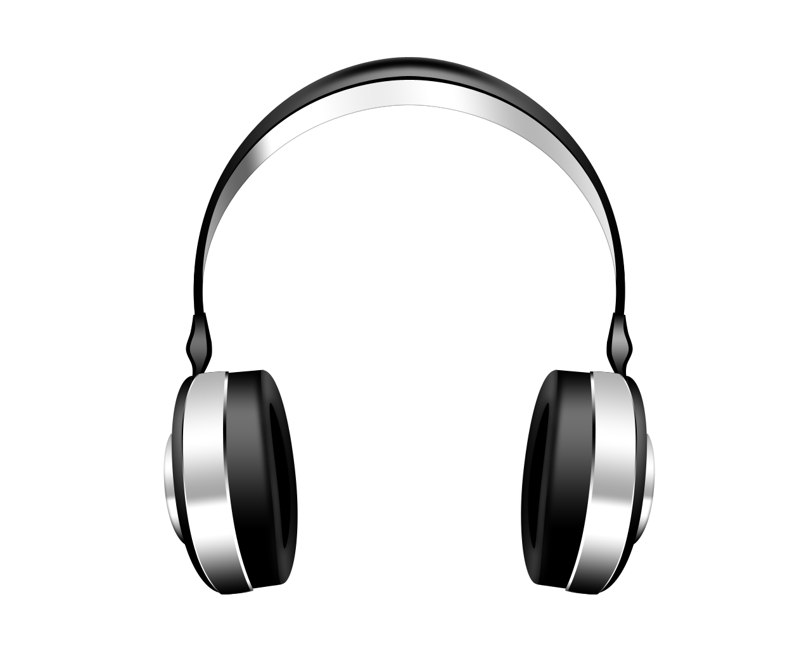
Adaptive Controller for the Disabled
By : Alvin Chen & Maggie Huang
WSTN 104, Section 61
Alternative Design 3

Slide 2
Agenda
Design Statement
Description of Alternate Design
Introduction of Alternate Design
Criteria Summaries
Requirements
Conclusion
References

Slide 3
Design Statement
Design a video game controller for people with little to no use of their arms.

Slide 4
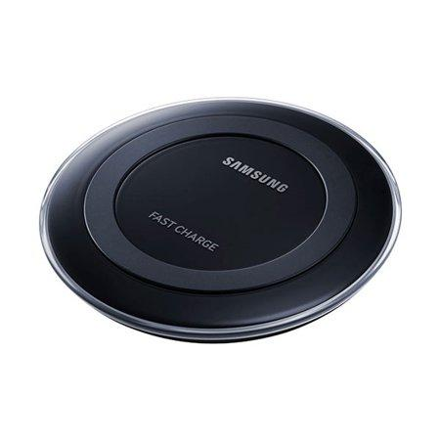
Description of Alternate Design (Both)
Wireless Charging
Bluetooth Connection
Easy to Clean
Interior is made out silicon/ rubber

Slide 5
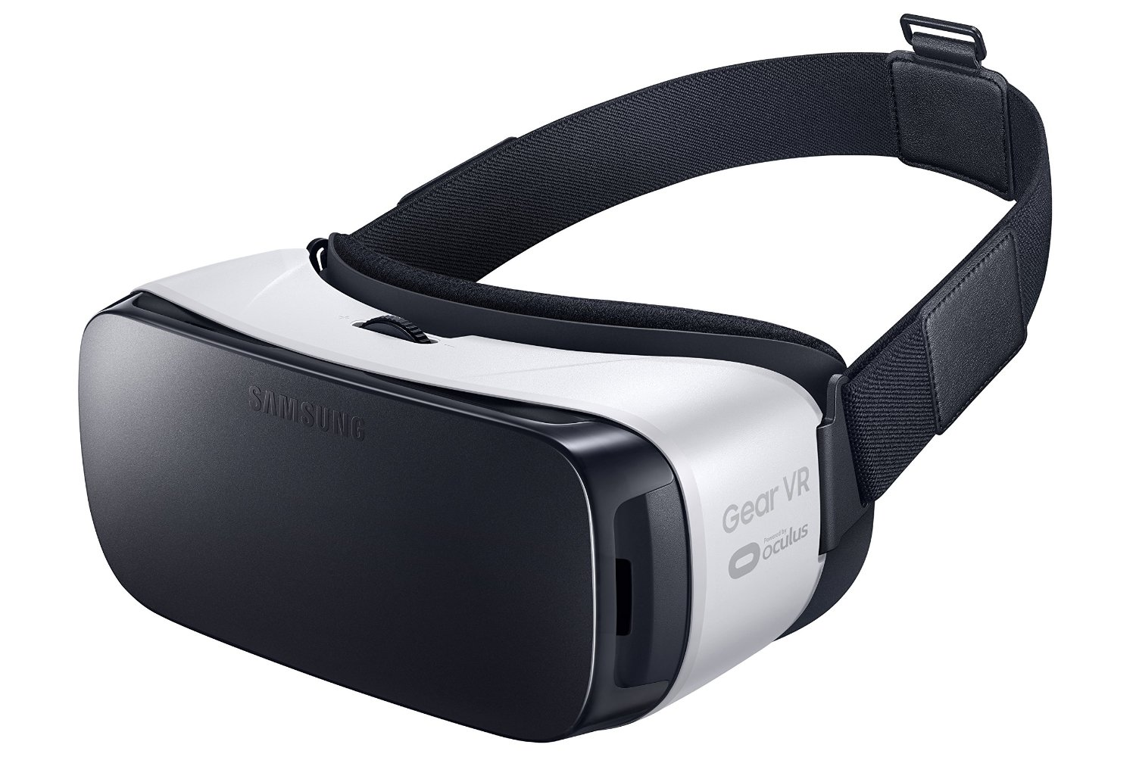
Description of Alternative Design (Headset)
Camera
Visor

Slide 6
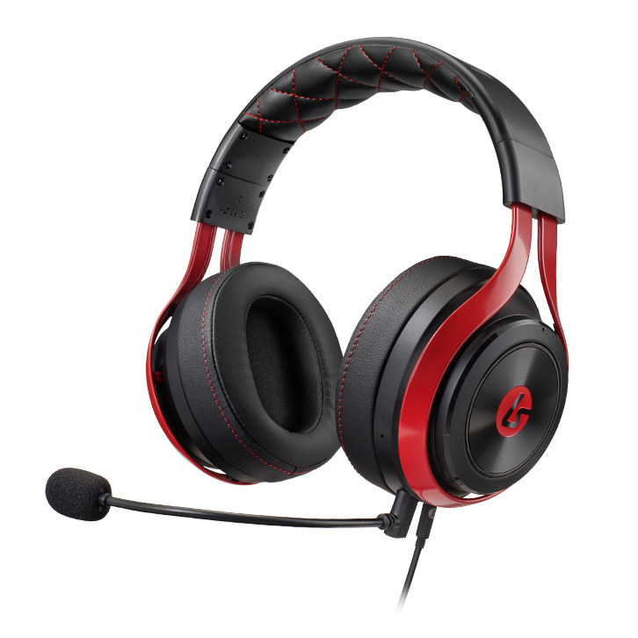
Description of Alternative Design (Headset) cont.
Ferrite/ Neodymium headphones
Microphone

Slide 7
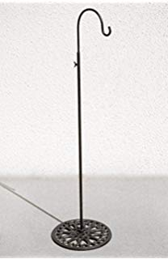
Description of Alternative Design (Headset) cont.
Adjustable Dimensions
Stand

Slide 8
Description of Alternative Design (Foot Control)
Bipedal
Home screen button in middle
Extra buttons for in game movements
On & off button
Distorted half sphere shape

Slide 9
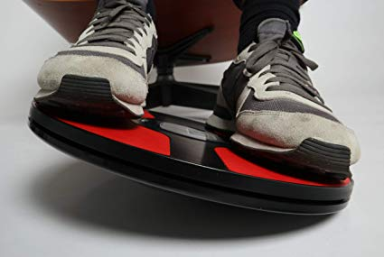
Description of Alternative Design (Foot Control) cont.
Disc top
11.5 in. diameter
Made of Al & other metals

Slide 10
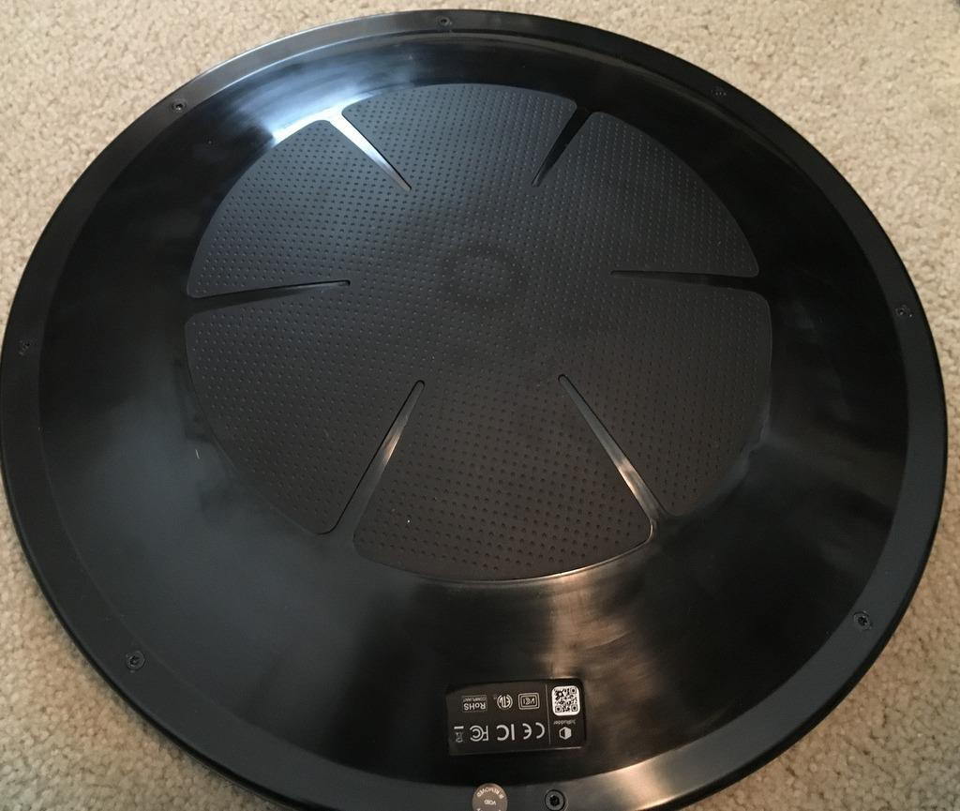
Description of Alternative Design (Foot Control) cont.
Rubber bottom - easy to clean
Half spherical shape
Allows for rocking

Slide 11
Introduction of Alt Design
Most of our requirements can be verified through Solid Edge
The rest can be verified by calculation and logical argument
While the one with power can be verified by LTSpice

Slide 12
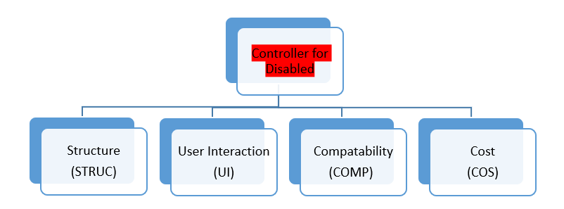

Slide 13
High Tier Requirements (Control)
[CONTROL 1.1] The device shall be usable by a single user with no arms.
The headset can be put on by the user via the stand.
The foot control is on the floor and uses foot for control

Slide 14
High Tier Requirements (Control) cont.
[CONTROL 1.2] The device shall be usable with all current major systems.
Our device can use the common 2.4 Gigahertz.

Slide 15
High Tier Requirements (Control) cont.
[CONTROL 1.3] The device shall not be a permanent fixture in a room.
The stand can be moveable as well as the headset.
Foot controller can also be moved.

Slide 16
High Tier Requirements (Control) cont.
[CONTROL 1.4] The device shall be usable in multiple locations in the home.
Our device is wireless and offers bluetooth services.

Slide 17
Pahl & Beitz Criteria
Criteria | Weight Factor (W)
Cost | 0.1
Structure | 0.25
User Interaction | 0.45
Compatibility | 0.2
Total | 1.0

Slide 18
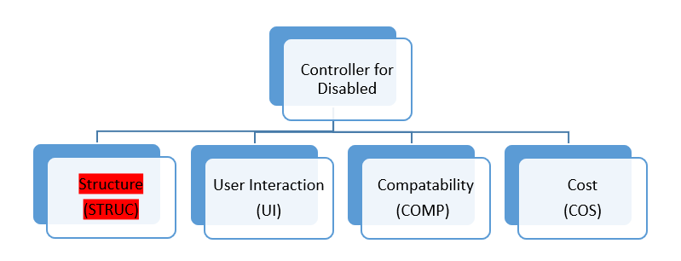

Slide 19
Structure
[STRUC 2.1] The device shall be less than 12 in. in width {CONTROL 1.4}
The headset is adjustable.
The average width of a human head is 6 to 7 inches wide.
The average male foot size is a size 10, roughly 10 inches.

Slide 20
Structure cont.
[STRUC 2.2] The device shall be less than 12 in. in depth {CONTROL 1.4}
The average length of the human head is 2 inches long.
The device does not need to be 12 inches deep to rock.

Slide 21
Structure cont.
[STRUC 2.3] The device shall be less than 5.5 in. in height {CONTROL 1.4}
The average height of a human head is 8 to 9 inches long.
The foot controller only needs to be 5 inches off the floor.

Slide 22
Structure cont.
[STRUC 2.4] The device shall be able to withstand a force of 170 lbs {CONTROL 1.1}.
Strong metals can withstand greater forces.

Slide 23
Structure cont.
[STRUC 2.5] The device shall not have any detachable parts of volume 1.25 inches in diameter and between 1 and 2.25 inches deep. {CONTROL 1.1}
The helmet itself would be full constructed with no removable parts.
The stand is extendable while the charger can be measured.
No part of the foot controller is detachable.

Slide 24
Structure cont.
[STRUC 2.6] The device shall meet electronic waterproofing standards for the industry. {CONTROL 1.1}
The external of the headset can be made out of IPX8, protecting the inside.
Other companies have produced waterproof headphones/ earpods.
The visor is made out of a plastic like glass.
There are no holes in the device and would be sealed with waterproof material.

Slide 25
Structure cont.
[STRUC 2.7] The device shall be rechargeable. {CONTROL 1.3, CONTROL 1.4}
The device can be charged wirelessly.

Slide 26
Structure cont.
[STRUC 2.8] The device shall weigh less than 10 lbs. {CONTROL 1.1}
An average helmets weigh around 4 pounds.
Previous foot controllers weigh an average of about 7 pounds.

Slide 27
Structure cont.
[STRUC 2.9] The device shall be easily liftable.{CONTROL 1.1, CONTROL 1.4}
The amount of force a human head can lift is around 520 pounds.
The average man can lift 155 pounds.

Slide 28
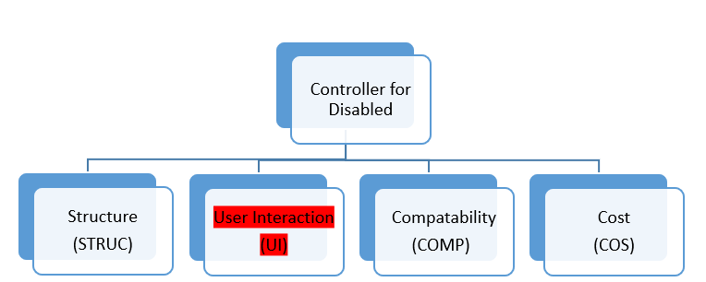

Slide 29
User Interaction
[UI 2.1] The device shall have the same input capabilities as standard video game controllers. {CONTROL 1.2}
Eye tracking can help select applications and access the menu.
The foot controller can move players (joystick) and can also hit in game things.

Slide 30
User Interaction cont.
[UI 2.2] The device shall be able to be turned on and off. {CONTROL 1.2}
There is an on a off button on the foot controller.

Slide 31
User Interaction cont.
[UI 2.3] The device shall have internal vibration capabilities. {CONTROL 1.2}
The helmet can vibrate a little alerting the user.

Slide 32
User Interaction cont.
[UI 2.4] The device shall have indicators. {CONTROL 1.2}.
The foot controller lights up when turned on and off.

Slide 33
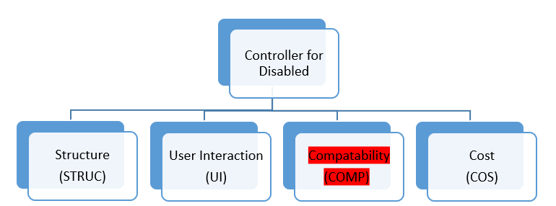

Slide 34
Compatibility
[COMP 2.1] The device shall have wireless connection to the console. {CONTROL 1.2, CONTROL 1.3, CONTROL 1.4}
The headset can be wireless attached to the console.
The foot control can also be wirelessly attached to the console via bluetooth.

Slide 35
Compatibility cont.
[COMP 2.2] The device shall have audio playback capabilities. {CONTROL 1.2}
The headset contains speakers on both sides allowing for audio capabilities.

Slide 36
Compatibility cont.
[COMP 2.3] The device shall have audio recording capabilities. {CONTROL 1.2}
The headset includes a microphone allowing for users to communicate with others.

Slide 37
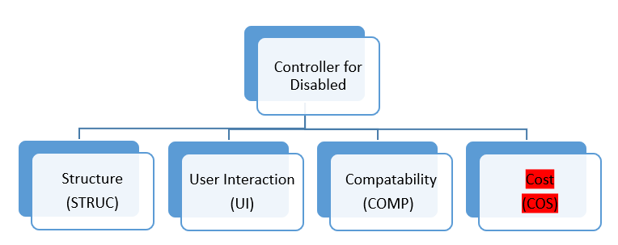

Slide 38
Cost
Since the headset includes eye tracking, it will be more expensive than a regular controller.
The foot controller would cost around $100-150 relative to other foot controllers in the market.
However, this enables the users to experience games different from before.

Slide 39
Conclusion
Our device can connect universally with other gaming company systems.
Easy to use and comfortable console.
Allows people with arm related disabilities to have fun.
Costs a little more than what is already in the market.

Slide 40
References
https://www.belkin.com/us/resource-center/wireless-charging/how-it-works/
https://www.benheck.com/guitar-hero-pedal-controllers/
https://www.digitaltrends.com/mobile/state-of-wireless-charging-2019/
https://www.independent.co.uk/life-style/health-and-families/features/why-our-feet-are-getting-bigger-9481529.html
https://www.livestrong.com/article/380767-how-much-weight-can-the-average-man-lift/
https://www.sciencedirect.com/science/article/pii/S2288430017301963
https://smallbusiness.chron.com/telephone-headset-work-34857.html
https://www.tobii.com/group/about/this-is-eye-tracking/
http://vrthegamers.com/hardware-review-3drudder-wants-put-feet-game/

Slide 41
Photo References
https://www.walmart.com/ip/Samsung-Qi-Certified-Fast-Charge-Wireless-Charging-Pad-2A-Wall-Charger-Supports-wireless-charging-Qi-compatible-smartphones-including-Samsung-Galaxy-/46821815
https://www.kidstoysnews.com/virtual-reality-headset-samsung-gear-vr-review/
https://www.lucidsound.com/ls25-esports-stereo-gaming-headset-lucidsound.html
https://www.amazon.com/Adjustable-Mannequin-Chrome-Stand-stand/dp/B00GVHW5KE
https://www.google.com/url?sa=i&source=images&cd=&cad=rja&uact=8&ved=2ahUKEwjWvfHt36LhAhUo8IMKHdU9AhUQjRx6BAgBEAU&url=https%3A%2F%2Fwww.gamingnexus.com%2FArticle%2F5577%2F3dRudder%2F&psig=AOvVaw1Gw-lxQ-NZZ7yc0pYEZrMD&ust=1553790776327558
https://www.google.com/search?q=3d+rudder&rlz=1C1CHBF_enUS747US747&source=lnms&tbm=isch&sa=X&ved=0ahUKEwiHy_ba36LhAhVJTd8KHQqNA2YQ_AUIDygC&biw=1536&bih=722#imgrc=-QtE4Kc0EpoJRM:

